Slide 1

Personal Management Merit Badge
Troop 344 and 9344
Pemberville, OH

Slide 2

Personal Management
Merit Badge Requirements
Do the following:
  Choose an item that your family might want to purchase that is considered a major expense.
  Write a plan that tells how your family would save money for the purchase identified in requirement 1a.
    Discuss the plan with your merit badge counselor
    Discuss the plan with your family
    Discuss how other family needs must be considered in this plan.
  Develop a written shopping strategy for the purchase identified in requirement 1a.
    Determine the quality of the item or service (using consumer publications or ratings systems).
    Comparison shop for the item. Find out where you can buy the item for the best price. (Provide prices from at least two different price sources.) Call around; study ads. Look for a sale or discount coupon. Consider alternatives. Can you buy the item used? Should you wait for a sale?

Slide 3

Personal Management
Merit Badge Requirements
Do the following:
  Prepare a budget reflecting your expected income (allowance, gifts, wages), expenses, and savings for a period of 13 consecutive weeks.
  Compare expected income with expected expenses.
    If expenses exceed budget income, determine steps to balance your budget.
    If income exceeds budget expenses, state how you would use the excess money (new goal, savings).
  Track and record your actual income, expenses, and savings for 13 consecutive weeks (the same 13-week period for which you budgeted). (You may use the forms provided in this pamphlet, devise your own, or use a computer-generated version.) When complete, present the records showing the results to your merit badge counselor.
  Compare your budget with your actual income and expenses to understand when your budget worked and when it did not work. With your merit badge counselor, discuss what you might do differently the next time.

Slide 4
Personal Management
Merit Badge Requirements
Discuss with your merit badge counselor FIVE of the following concepts:
  The emotions you feel when you receive money.
  Your understanding of how the amount of money you have with you affects your spending habits.
  Your thoughts when you buy something new and your thoughts about the same item three months later. Explain the concept of buyer's remorse.
  How hunger affects you when shopping for food items (snacks, groceries).
  Your experience of an item you have purchased after seeing or hearing advertisements for it. Did the item work as well as advertised?
  Your understanding of what happens when you put money into a savings account.
  Charitable giving. Explain its purpose and your thoughts about it.
  What you can do to better manage your money.

Slide 5
Personal Management
Merit Badge Requirements
Explain the following to your merit badge counselor:
  The differences between saving and investing, including reasons for using one over the other.
  The concepts of return on investment and risk and how they are related.
  The concepts of simple interest and compound interest.
  The concept of diversification in investing.
  Why it is important to save and invest for retirement.
Explain to your merit badge counselor what the following investments are and how each works:
  Common stocks
  Mutual funds
  Life insurance
  A certificate of deposit (CD)
  A savings account
  A U.S. savings bond

Slide 6
Personal Management
Merit Badge Requirements
Explain to your counselor why people might purchase the following types of insurance and how they work:
  Automobile
  Health
  Homeowner's/renter's
  Whole life and term life
Explain to your merit badge counselor the following:
  What a loan is, what interest is, and how the annual percentage rate (APR) measures the true cost of a loan.
  The different ways to borrow money.
  The differences between a charge card, debit card, and credit card. What are the costs and pitfalls of using these financial tools? Explain why it is unwise to make only the minimum payment on your credit card.
  Credit reports and how personal responsibility can affect your credit report.
  Ways to reduce or eliminate debt.

Slide 7
Personal Management
Merit Badge Requirements
Demonstrate to your merit badge counselor your understanding of time management by doing the following:
  Write a "to do" list of tasks or activities, such as homework assignments, chores, and personal projects, that must be done in the coming week. List these in order of importance to you.
  Make a seven-day calendar or schedule. Put in your set activities, such as school classes, sports practices or games, jobs or chores, and/or Scout or place of worship or club meetings, then plan when you will do all the tasks from your "to do" list between your set activities.
  Follow the one-week schedule you planned. Keep a daily diary or journal during each of the seven days of this week's activities, writing down when you completed each of the tasks on your "to do" list compared to when you scheduled them.
  With your merit badge counselor, review your "to do" list, one-week schedule, and diary/journal to understand when your schedule worked and when it did not work. Discuss what you might do differently the next time.

Slide 8
Personal Management
Merit Badge Requirements
Prepare a written project plan demonstrating the steps below, including the desired outcome. This is a project on paper, not a real-life project. Examples could include planning a camping trip, developing a community service project or a school or religious event, or creating an annual patrol plan with additional activities not already included in the troop annual plan. Discuss your completed project plan with your merit badge counselor.
  Define the project. What is your goal?
  Develop a timeline for your project that shows the steps you must take from beginning to completion.
  Describe your project.
  Develop a list of resources. Identify how these resources will help you achieve your goal.
  Develop a budget for your project.

Slide 9
Personal Management
Merit Badge Requirements
Do the following:
  Choose a career you might want to enter after high school or college graduation. Discuss with your counselor the needed qualifications, education, skills, and experience.
  Explain to your counselor what the associated costs might be to pursue this career, such as tuition, school or training supplies, and room and board. Explain how you could prepare for these costs and how you might make up for any shortfall.

Slide 10
Requirement 1
Do the following:
  Choose an item that your family might want to purchase that is considered a major expense.
  Write a plan that tells how your family would save money for the purchase identified in requirement 1a.
    Discuss the plan with your merit badge counselor
    Discuss the plan with your family
    Discuss how other family needs must be considered in this plan.
  Develop a written shopping strategy for the purchase identified in requirement 1a.
    Determine the quality of the item or service (using consumer publications or ratings systems).
    Comparison shop for the item. Find out where you can buy the item for the best price. (Provide prices from at least two different price sources.) Call around; study ads. Look for a sale or discount coupon. Consider alternatives. Can you buy the item used? Should you wait for a sale?

Slide 11

Meeting a Family Financial Goal
Generally, a major expense can be thought of as a cost either greater than 10% of a parent’s monthly income or needing to incur debt that would need to be paid back over time.
Purchases that are considered major expenses for most families:
  Car
  Roof
  Television
  Furnace/Air Conditioning System
  Boat
  Computer/Gaming System
  College Tuition
  Washing Machine/Dryer
  Vacation
Download the “Major Expense Worksheet” that accompanies this presentation to help you with the completion of Requirement 1.

Slide 12
Meeting a Family Financial Goal
Major family Purchase – New Sony Flat Screen TV (Cost: $750).
  The question that needs to be asked is, “How much money does the family have leftover after all necessities are paid for?”
A budget is essential to track how much money your family makes in a month versus how much money they spend.
Recognizing where you’re spending money every month allows you to see if you can reduce any of those costs.
Spending less than is made allows the extra to be saved for other purchases such as a $750 TV.
  Saving $250 every month will require 3 months.
  Saving $75 every month will require 10 months.

Slide 13
Comparison Shopping
Compare prices of competing sellers and comparable products in order to find the best value.
Comparison shopping strategy using the TV example:
  Research the item: Look for the features you desire.
  Determine quality: Go to Amazon and look at the Sony TV’s ratings and customer feedback.
  Consider alternatives: Scroll down to check out the ‘Customers who viewed this item also viewed’ section to see other top TVs that are similar to the Sony TV.
  Comparison shop: Take the top three TVs with 4+ star ratings and do a general Google search to see if there are any lower prices available.
  Make an informed decision: Given each model’s lowest available price, buy the TV that provides the greatest benefits relative to its cost from a reputable seller.
  Factor in delivery fees and taxes as part of the overall price.

Slide 14
Comparison Shopping for Typical Household Purchases
Understanding the Unit Price
Look at a shelf price tag in the grocery store and you’ll zero in first on the price in the larger font.
  That price is telling you how much you’ll pay for the entire package of goods.
Look a little closer and you’ll also see a smaller number that will tell you the price per ounce/pound/liter/cookie you’ll pay when you buy that package.
  This number is the unit price and it’s there to help you compare products when they come in different-sized packages.
  It basically breaks down the cost per cookie when you’re looking at two packages — say, one with 24 cookies and the other with 12 — so you can find the better buy without doing any math.

Slide 15
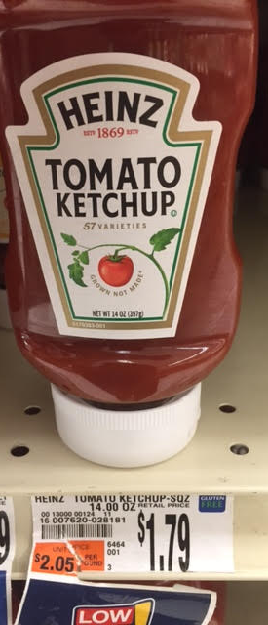
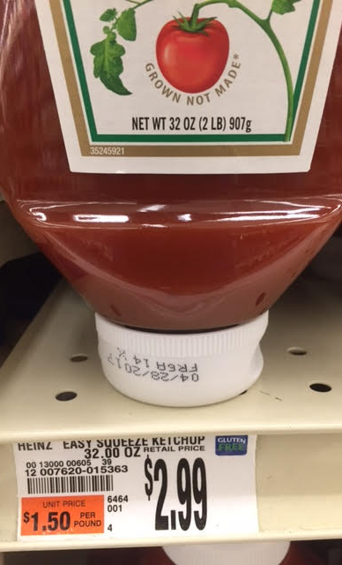
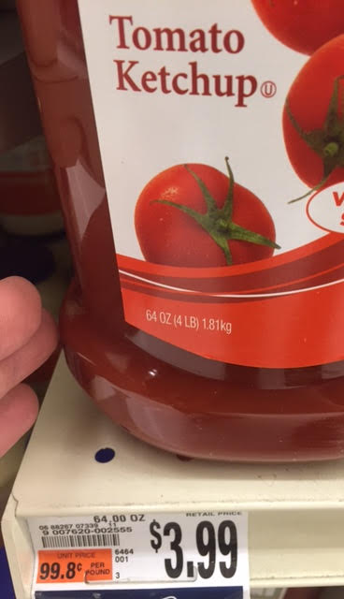
Which One Is the Better Buy?
14 oz.
At
$1.79
32 oz.
At
$2.99
64 oz.
At
$3.99
Unit Price: $2.05/lb.
Unit Price: $1.50/lb.
Unit Price: 99.8¢/lb.

Slide 16
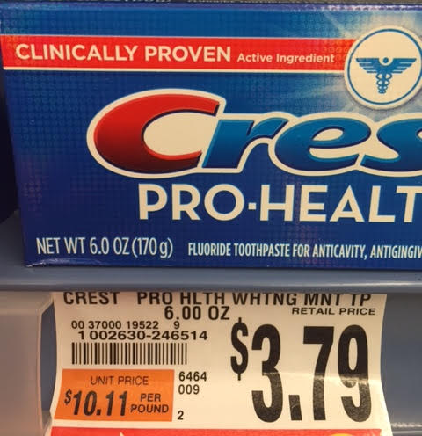
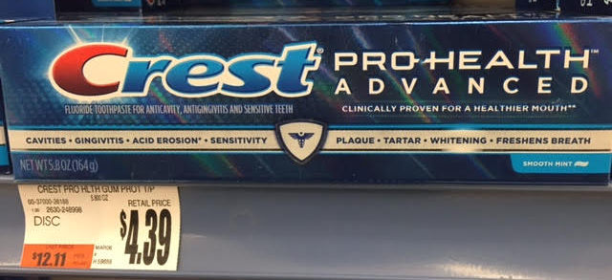
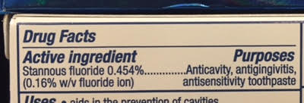
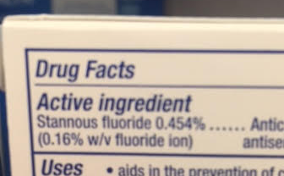
Be an Informed Shopper
5.1 oz. Tube $4.97 - 97.5¢/oz.
4.3 oz. Tube $3.97 - 92.3¢/oz.
Which is better for your teeth? Pro-Health or Pro-Health Advanced? Note: The cost per oz. for the same active ingredients.

Slide 17

Customer Satisfaction
While shopping, ask about guarantees, return policies, and service policies.
A store might have a great price on a product, but it might not have a service center to support the repair of the product.
If there is a problem with the product, return it to the store promptly.
  Be sure to keep your receipt.
  Most stores want to ensure customer satisfaction and will offer to replace the product or repair it.
  Ask to speak to the manager if the problem is not addressed to your satisfaction.

Slide 18
Requirement 2
Do the following:
  Prepare a budget reflecting your expected income (allowance, gifts, wages), expenses, and savings for a period of 13 consecutive weeks.
  Compare expected income with expected expenses.
    If expenses exceed budget income, determine steps to balance your budget.
    If income exceeds budget expenses, state how you would use the excess money (new goal, savings).
  Track and record your actual income, expenses, and savings for 13 consecutive weeks (the same 13-week period for which you budgeted). (You may use the forms provided in this pamphlet, devise your own, or use a computer-generated version.) When complete, present the records showing the results to your merit badge counselor.
  Compare your budget with your actual income and expenses to understand when your budget worked and when it did not work. With your merit badge counselor, discuss what you might do differently the next time.

Slide 19
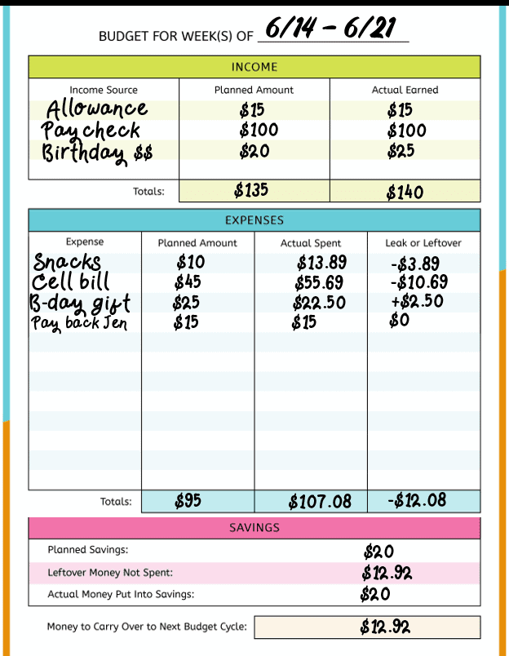
Budgeting
What is a Budget?
  A budget is an estimate of how much money you’ll make and spend over a certain period of time, such as a month or year.
What’s the purpose of a budget?
  Budgeting is about taking control of your money.
  Making a budget shouldn’t feel like a punishment, but a plan for all of your money - that includes money for fun stuff, too.
  A budget doesn’t have to be rigid.
  Budgets need to change as your circumstances change because surprises and mistakes will happen.
  While a budget is easy to understand, it takes self-discipline to follow.
  Self-discipline is probably the most important single factor in helping you to attain your personal goals.

Slide 20
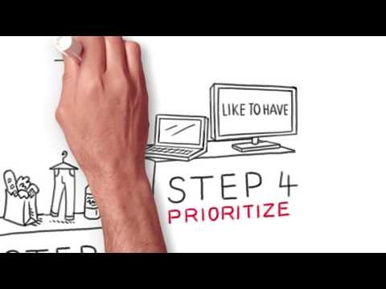
Learning to Budget
Click on the video for a quick walkthrough on budgeting.

Slide 21
Pay Yourself First Budget
The "pay yourself first" method has you put a portion of your paycheck into your savings or retirement before you do anything else with it.
When you add to your savings immediately after you get paid, your monthly spending naturally adjusts to what's left.
Paying yourself first can be effective because it ensures you save something every pay period, and it eliminates the possibility that you'll spend money you intended to save.
What are examples of paying yourself first?
  Your employer withdraws part of your paycheck for a retirement savings plan such as a 401(k) or 403(b).
  You set up direct deposit so that a portion of each paycheck goes to a savings account while the rest goes to checking.
Paying yourself first describes any scenario in which you prioritize saving or investing for the future ahead of other expenses.

Slide 22
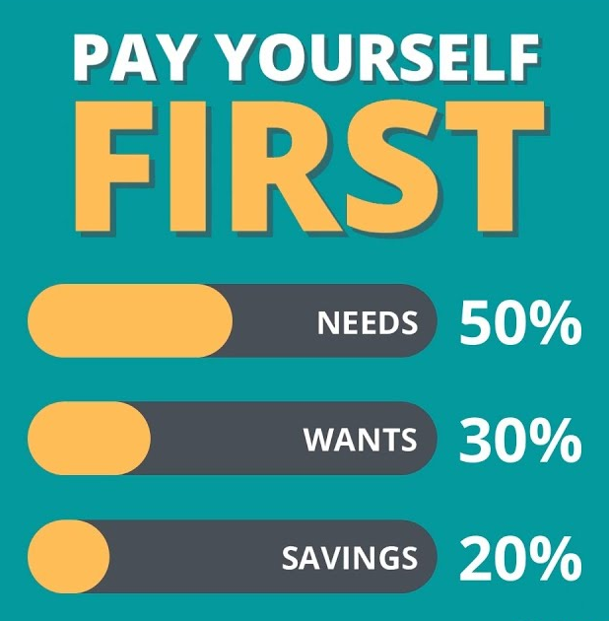
How Do You Pay Yourself First?
Keep your savings in a separate account from your spending money to avoid temptation to spend your savings.
Set up direct deposit of your paycheck so that the money you’ve earmarked for savings never enters your spending account.
Paying yourself first requires balance.
  Choose a reasonable amount or percentage of your check that won't leave you unable to pay your bills or meet other financial obligations.
  Try to save enough to make a difference in your savings account balance.
  To find the sweet spot, you'll need to take a close look at your budget.

Slide 23
What percentage should you pay yourself?
To determine the right amount for you to save each month, you will need to craft a budget.
Here's how to examine your income and expenses:
  Determine your monthly take-home pay (your income after taxes and retirement contributions are withheld).
  Setting aside 10-20% of your income is a good target for savings, although the right amount will vary based on your circumstances.
  Track your expenses—including housing, utilities, loan payments, transportation costs, childcare, food, medical expenses and other bills.
  Plug the numbers into the equation: Income – Savings – Expenses = Spendable.
  The result is your spendable income, or the amount of money that's available to spend without putting any essential bills, or your savings, in jeopardy.
Make sure you're happy with the amounts you're saving and spending, and ask yourself if there are opportunities to spend less.
When you find ways to cut expenses, you can use the money you're freeing up to boost your savings.

Slide 24

Make the Savings Automatic
Once you've arrived at a number you're comfortable with, set up automatic deposits from your paycheck into a dedicated savings or investment account to ensure you always get paid first.
  One option is to set up a split direct deposit so that for each paycheck, the pay-yourself-first money goes into your designated savings account while the rest goes to your general checking account.
  Another option is to set up a recurring transfer that moves money from your general account to your designated savings account at a certain time every month or pay period.
Do not put the money into the account that you use for day-to-day expenses.
  It is too easy to accidentally spend or lose track of.

Slide 25
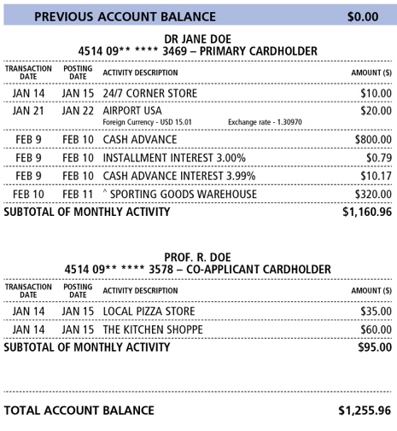
Methods to Track Expenditures
Checks and credit cards
  These expenditures leave a paper trail.
  Download the “Check Writing Exercise” that accompanies this presentation to learn how to correctly write a check.
Cash
  Record expenditures in a notebook
Computer programs, i.e., Quicken, Money or spreadsheets
  These are very useful, especially if tied to bank and credit card companies
  Generate a monthly record of spending and income

Slide 26
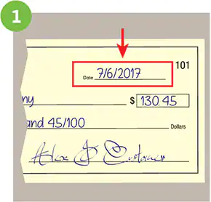
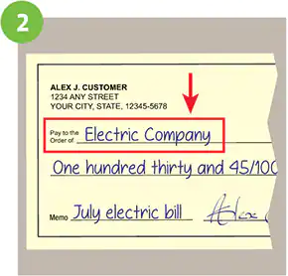
How to Write a Check
Step 1: Date the check
  Write the date on the line at the top right-hand corner. This step is important so the bank and/or person you are giving the check to knows when you wrote it.
Step 2: Who is this check for?
  The next line on the check, “Pay to the order of,” is where you write the name of the person or company you want to pay. You can also just write the word “cash” if you don’t know the person or organization’s exact name. Be aware, though, that this can be risky if the check ever gets lost or stolen. Anybody can cash or deposit a check made out to “cash."

Slide 27
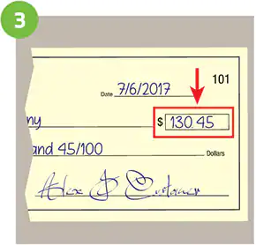
How to Write a Check
Step 3: Write the payment amount in numbers
  There are two spots on a check where you write the amount you are paying. First, you’ll need to write the dollar amount numerically (for example $130.45) in the small box on the right. Be sure to write this clearly so the ATM and/or bank can accurately subtract this amount from your account.

Slide 28
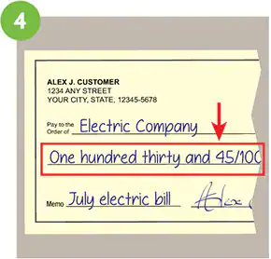
How to Write a Check
Step 4: Write the payment amount in words
  On the line below “Pay to the order of,” write out the dollar amount in words to match the numerical dollar amount you wrote in the box. For example, if you are paying $130.45, you will write “one hundred thirty and 45/100.” To write a check with cents, be sure to put the cents amount over 100. If the dollar amount is a round number, still include “and 00/100” for additional clarity. Writing the dollar amount in words is important for a bank to process a check as it confirms the correct payment total.
  Remember to draw a line after the written-out amount of the check to fill out that space. This helps prevent someone from altering the amount of the check after you've written it.

Slide 29
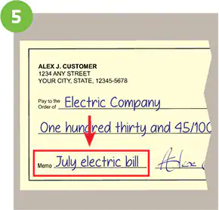
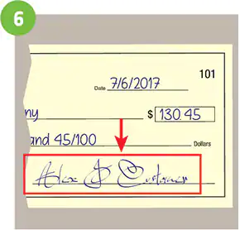
How to Write a Check
Step 5: Write a memo
  Filling out the line that says “Memo” is optional, but helpful for knowing why you wrote the check. If you are paying a check for a monthly electric bill or rent, you can write “Electric Bill” or “Monthly Rent” in the memo area. Often when you are paying a bill, the company will ask you to write your account number on the check in the memo area.
Step 6: Sign the check
  Sign your name on the line at the bottom right-hand corner using the signature you used when you opened the checking account. This shows the bank that you agree that you are paying the stated amount and to the correct payee.

Slide 30
Preparing a Budget
Download the “Budget Preparation Exercise” that accompanies this presentation to help you with the completion of Requirement 2.
Prepare a personal budget for 3 months.
Put money into savings (Pay Yourself First) before spending it on anything else.
Keep track of everything you buy.
Balance your income (money you receive) with your savings and expenses (things you spend money on).

Slide 31

Report to Your Counselor
After the 3 months, share your budget with your counselor.
Explain how you determined how much you saved, what you spent money on, and what was left over.
Did you spend more or less than you budgeted?
Did your purchasing habits change? If so, how?

Slide 32
Requirement 3
Discuss with your merit badge counselor FIVE of the following concepts:
  The emotions you feel when you receive money.
  Your understanding of how the amount of money you have with you affects your spending habits.
  Your thoughts when you buy something new and your thoughts about the same item three months later. Explain the concept of buyer's remorse.
  How hunger affects you when shopping for food items (snacks, groceries).
  Your experience of an item you have purchased after seeing or hearing advertisements for it. Did the item work as well as advertised?
  Your understanding of what happens when you put money into a savings account.
  Charitable giving. Explain its purpose and your thoughts about it.
  What you can do to better manage your money.

Slide 33

Emotions You Feel when You Receive Money
  When receiving money, you’ll likely feel a rush of joy and excitement in anticipation of what that money can buy for you.
    Large amounts of money can make people act irrationally and take on unnecessary risks.
  Having extra money on hand can lead to impulse buying.
    Purchasing something without planning to do so beforehand.
Too many impulse purchases can eat away at your monthly budget, leaving you struggling to pay your regular bills.

Slide 34
5 Ways to Limit Impulse Buying
  Stick to a list - A shopping list will help you be more intentional and less impulsive. If it’s not on your list, it doesn't mean you can’t buy it tomorrow; it just means you shouldn’t buy it today.
  Give yourself a pause – Put a pause between the urge and action. Maybe walk a lap around the parking lot before checking out or tell yourself you can buy the item tomorrow but not today. (And by tomorrow you may have cooled on the idea.)
  Take the convenience out of online shopping - Mobile phones make it easy to impulse buy with a couple of taps or clicks. Avoid keeping your payment information on file with retailers. That way, you have to stop and enter your information for every online shopping purchase. Take it a tiny step further and move shopping apps off your phone’s home screen.
  Reflect on why you shop - Consider when and why you tend to overshop. What were you feeling and experiencing the last few times you bought something impulsively? Write it down. Ideally, you can start to understand your internal and external triggers and how to manage them. Limit online shopping triggers by unsubscribing from tempting retailer emails.
  Replace emotional shopping with a free activity – If you realize you tend to shop when you’re sad, ask yourself what else cheers you up. For instance, rather than wandering into the mall when you're blue, perhaps you call a friend or walk in nature.

Slide 35

Buyers Remorse
Oftentimes, we buy something and are elated when first opening that new toy or gadget.
Buyer’s remorse is when sometime later you regret that decision.
How to avoid buyers remorse
  Wait at least 72 hours before making a purchase.
    If after this time, you still want the item then you are less likely to have remorse. Giving yourself a moment to think can be the difference between making an informed or a rushed decision. Be very wary of companies that create a false sense of scarcity. When you see “hurry – only 3 items left”, know that this often isn’t the case.
  Equate working hours to the price of the item.
    Calculate how many hours you would have to work to pay for the purchase. Is it still worth it? Thinking in terms of working hours helps to root your purchase in reality.

Slide 36

Shopping for Food when Hungry
Going grocery shopping on an empty stomach is a bad idea.
Studies have shown that shoppers who reported being hungry spent 64 percent more money and impulsively bought more non-food items than less hungry customers.
Additionally, unhealthy food becomes much more attractive than healthy food.
If you want to save money, avoid shopping while hungry.
Otherwise you may end up spending money on items you don't want or need.

Slide 37

Advertised Products
Advertising informs you of available products, their features and benefits, where they can be bought and at what price.
Advertising can also be misleading.
  False advertising is propaganda that exists to compel a consumer to purchase based on incorrect or deceptive information.
  Advertising is misleading if it left out vital information about a product or service.

Slide 38
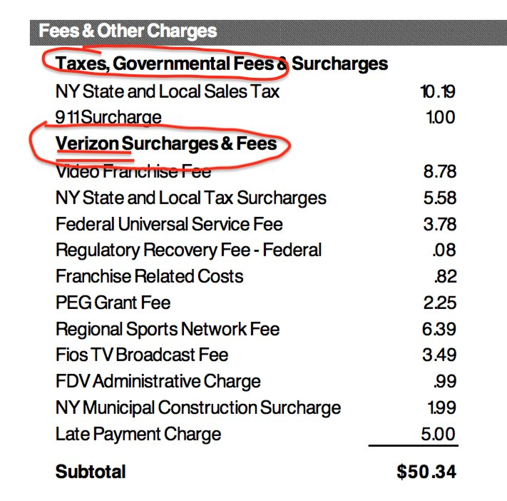
Misleading Advertisements Examples
  Product Misrepresentation
    Misrepresenting one’s product usually entails it looking different or having different qualities than stated in the ad.
    Brands most often misrepresent things like the product’s color, size, and look.
    They may also misrepresent their product’s health benefits, give it false attributes (like environmentally friendly), or inconsistently compare it to their competitors.
Hidden Fees
  This category includes any extra fees that aren’t stated in an advertisement (e.g., shipping costs, surcharges) or even products with falsely inflated prices so that the sellers could advertise them as on sale.
  New and Improved
    Make sure you find out what has been improved.
    The improvement could be so slight that it might be better to buy the older model at a cheaper price.

Slide 39

Misleading Advertisements Examples
  Athlete Endorsements
    Does the product really deliver the benefits that advertisements claim it does.
    Just because a great athlete wears a certain brand of shoes does not mean that your athletic skills will improve if you wear the same brand..
Bait-and-Switch
  This technique promotes a very low price on a particular item (bait), but when you try to buy it, the salesperson tries to sell you something “better” at a higher price (switch).

Slide 40

Savings Accounts
What is a savings account?
  A savings account is a deposit account that typically earns interest, is federally insured and held at a financial institution, such as a bank or credit union.
  With an interest-bearing account, the bank pays you to keep your funds deposited, with annual percentage yields on some accounts reaching over 5%.
  Savings accounts are federally insured up to at least $250,000.
  This means you won’t lose your money (up to at least $250,000) if the bank fails.
Why you need a savings account
  Using a savings account creates some distance between everyday spending money that’s kept in your checking account and cash that's needed later, whether for an unexpected emergency, a planned vacation or any other reason.
  Savings accounts also typically earn more interest than checking accounts.

Slide 41
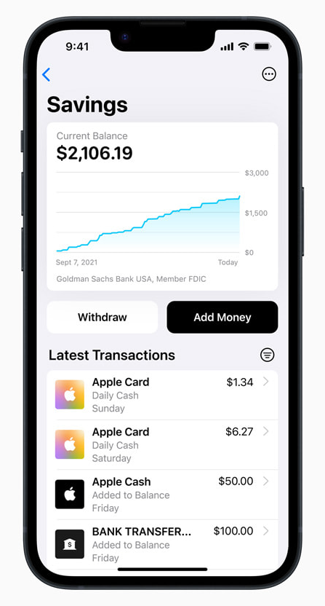
Savings Accounts
What you need to know about savings accounts
  When you put money in a savings account, the funds are used by the bank to make loans to other customers and businesses.
  The bank makes money from those loans, so it is able to pay you a little interest in return.
  But "a little interest" is all too true for many big banks, which often offer low rates of 0.01% APY.
  Additionally, inflation can chip away at the value of money you have saved over time.
How much to keep in your savings account
  You generally want to keep building up your savings account until you reach an amount that could cover three to six months’ worth of living expenses.
  That can help protect you in case of job loss or a financial emergency.

Slide 42

Charitable Giving
Charitable giving is the act of giving money, time, or goods to help create positive changes in society.
Charitable giving can come in the form of donating to a food bank, financially supporting nonprofit organizations, or volunteering your time at a local community program.
No matter how you choose to donate, charitable giving can help improve quality of life for others, strengthen community bonds, and can boost your emotional well-being.

Slide 43
How to Better Manage Your Money
Track your spending to improve your finances.
  If you don’t know what and where you’re spending each month, there’s a good chance your personal spending habits have room for improvement.
  Better money management starts with spending awareness. Track your spending to see how much you’re spending on non-essentials such as dining, entertainment, and even that daily coffee. Once you’ve educated yourself on these habits, you can make a plan to improve.
Create a realistic monthly budget.
  Use your monthly spending habits, as well as your monthly take-home pay, to set a budget you know you can keep.
  You should see a budget as a way to encourage better habits, such as cooking at home more often, but give yourself a realistic shot at meeting this budget. That’s the only way this money management method will work.

Slide 44
How to Better Manage Your Money
Build up your savings—even if it takes time.
  Create an emergency fund that you can dip into when unforeseen circumstances strike. Even if your contributions are small, this fund can save you from risky situations in which you’re forced to borrow money at high-interest rates or possibly find yourself unable to pay your bills on time.
Pay your bills on time every month.
  Pay bills on time.
  It helps you avoid late fees and prioritizes essential spending.
  A strong on-time payment history can also lift your credit score and improve your interest rates.
Cut back on recurring charges.
  It’s easy to forget about monthly subscriptions to streaming services and mobile apps that charge your bank account even when you don’t regularly use these services.
  Review your spending for charges like these, and consider canceling unnecessary subscriptions to hold onto more money each month.

Slide 45
How to Better Manage Your Money
Save up cash to afford big purchases.
  Certain kinds of loans and debt can be helpful when making major purchases, such as a house or a car.
  But for other big purchases, cash offers the safest and cheapest buying option.
  When you buy in cash, you avoid generating interest and creating a debt that requires months, or often years, to pay back.
  In the meantime, that saved money can sit in a bank account and accumulate interest that can be put toward your purchase.
Start an investment strategy.
  Even if your ability to invest is limited, small contributions to investment accounts can help you use your earned money to generate more income.
  The path to better finances starts with changing your own habits.
  Some of these changes will be easier than others, but if you stay committed to this transformation, you’ll end up with great money management skills that will serve you throughout your life.

Slide 46

Requirement 4
Explain the following to your merit badge counselor:
  The differences between saving and investing, including reasons for using one over the other.
  The concepts of return on investment and risk and how they are related.
  The concepts of simple interest and compound interest.
  The concept of diversification in investing.
  Why it is important to save and invest for retirement.

Slide 47
Comparing Saving vs. Investing
Saving | Investing
For the short term. Typically for smaller, shorter-term goals in the near future like saving for a large purchase or for an emergency. | Usually used for long-term goals. Investing may help you reach long-term goals, such as paying for a child’s education or planning for retirement.
Ready access to cash. A savings account can give you access to cash when you need it. | Longer wait to access invested funds. When you invest your money, depending on the type of investment, it may take longer to access your money compared to a savings account.
Involves minimal risk. Your funds are insured by the Federal Deposit Insurance Corporation (FDIC) up to $250,000 per depositor, per FDIC-insured bank, per ownership category. | Always involves risk. Investing does not guarantee a return, and it is possible to lose some or all of the funds invested.
Earn interest. You can earn interest by putting money in a savings account, but savings accounts generally earn a lower return than investments. | Earnings potential. Investments typically have the potential for higher return than a savings account.

Slide 48

Return on Investment
Return on Investment (ROI) is a popular measurement used to evaluate how well an investment has performed.
Whether or not something delivers a good ROI should be compared relative to your other investments and available opportunities.
The return on investment (ROI) formula is as follows:
  "Current Value of Investment” refers to the proceeds obtained from the sale of the investment.
Because ROI is measured as a percentage, it can be easily compared with returns from other investments, allowing one to measure a variety of types of investments against one another.

Slide 49

Risk and Return
Risk and return are directly related.
  The greater the risk that an investment may lose money, the greater its potential for providing a substantial return.
  By the same token, the smaller the risk an investment poses, the smaller the potential return it will provide.
You should balance risk and return in your overall portfolio by diversifying.
This way means that some of your investments have the potential to provide strong returns (higher risk) while others ensure that part of your principal is secure (lower risk).

Slide 50
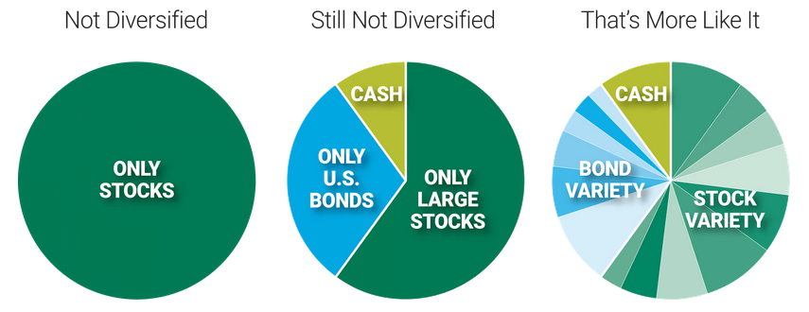
Diversification in Investments
Diversification is the act of spreading investment dollars across a range of assets to reduce investment risk.
To appropriately diversify a portfolio, you’ll need to include stocks from many different sectors.
Even still, you may also want to include bonds or other fixed income securities to protect against a dip in the stock market as a whole.
Diversification is the simplest way to boost your investment returns while reducing risk.
By choosing not to put all of your eggs in one basket, you protect your portfolio from market volatility.

Slide 51
The Benefits of Diversification
Diversification reduces overall risk while increasing the potential for overall return.
  Some assets will perform well while others do poorly.
  Next year their positions could be reversed, with the former laggards becoming the new winners.
Over short-term periods, returns can vary widely.
A well-diversified stock portfolio tends to earn the market’s average long-term historic return.
  Owning a variety of assets minimizes the chances of any one asset hurting your portfolio.
  The trade-off is that you never fully capture the startling gains of a shooting star.
The net effect of diversification is slow and steady performance and smoother returns, never moving up or down too quickly.
This reduced volatility puts many investors at ease.

Slide 52
Diversification by Asset Class
The three main general asset classes in an investment portfolio are stocks, bonds and cash.
Stocks (or equities) allow investors to own a piece of a company.
  Stocks offer the highest long-term gains but are more risky.
Bonds (or fixed income) pay interest to investors who lend money to a company or government.
  Bonds are income generators with modest returns (less risky).
  Generally, bonds have an inverse relationship with stocks.
Cash (or cash equivalents) is the money in your savings account, pocket or hidden under your pillow.
  In terms of risk and return, cash is low on both counts.
  Cash can buffer volatility or unexpected expenses and acts as a reserve to invest during opportune times.

Slide 53
Simple versus Compound Interest
Interest is defined as the cost of borrowing money, as in the case of interest charged on a loan balance.
Conversely, interest can also be the rate paid for money on deposit, as in the case of a certificate of deposit.
Interest can be calculated in two ways: simple interest or compound interest.
  Simple interest is calculated on the principal, or original amount of a loan.
  Compound interest is calculated on the principal amount and the accumulated interest of previous periods, and thus can be regarded as “interest on interest.”
There can be a big difference in the amount of interest payable on a loan if interest is calculated on a compound basis rather than on a simple basis.
The magic of compounding can work to your advantage when it comes to your investments and can be a potent factor in wealth creation.

Slide 54

Simple versus Compound Interest
Click on the video for a demonstration of the differences between simple and compound interest..

Slide 55
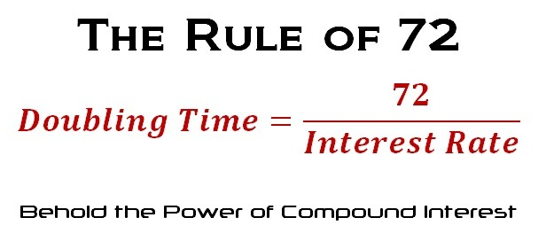
The Rule of 72
The Rule of 72 helps you determine when an investment using compounded interest will double in value.
This formula requires you to input the rate of return or interest on the investment, and it also assumes that compounding is only done annually.
Simply use the formula (72/interest) and you will have the answer to how many years it will take for your investment to double.
  For example, if you invested $1000 and your annual rate of return is 10%, your formula would be (72/10), equating to 7.2 years before your investment is doubled to $2000.

Slide 56
Why is retirement planning important?
Saving now for retirement will ensure that you have enough money to enjoy a comfortable standard of living when you stop or reduce the amount of hours you work.
  Social Security wasn't designed to be anyone's sole income in retirement.
  Social Security payments replace about 40% of the average wage earner’s income after retiring.
  Most financial advisors say retirees will need about 70% of their work income to live comfortably in retirement..
The earlier you start planning, the more time your money has to grow.
  Even modest monthly contributions to a retirement account for 30 to 40 years can easily lead to an accumulation of several hundred thousand dollars through the miracle of compound interest.
The longer you wait to start saving, the more difficult it is to ensure that you will have a comfortable retirement.

Slide 57
Requirement 5
Explain to your merit badge counselor what the following investments are and how each works:
  Common stocks
  Mutual funds
  Life insurance
  A certificate of deposit (CD)
  A savings account
  A U.S. savings bond
Download the “$10,000 Exercise” that accompanies this presentation to help you with the completion of Requirement 5.

Slide 58

Common Stock
Common stock is a representation of partial ownership in a company and is the type of stock most people buy.
Common stock comes with voting rights.
Common shareholders have the most potential for profit.
If a company chooses to distribute some of their profits to common stockholders in the form of dividends, each common stockholder is entitled to a proportional share.
  If a company declares a dividend of $10 million and there are 20 million shareholders, common stockholders will receive $0.50 for each share they own.
In the event of bankruptcy, common stockholders have the lowest-priority claim on a company's assets.
As a result, common stockholders generally receive nothing and their shares become worthless.

Slide 59
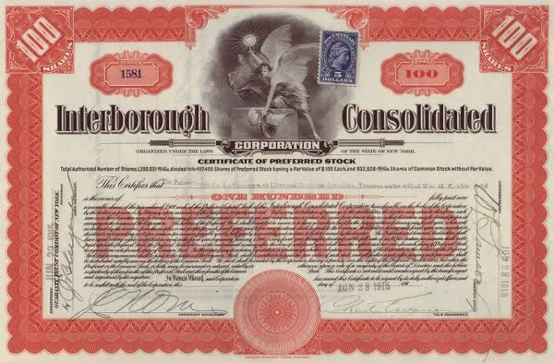
Preferred Stock
Preferred stockholders usually don’t have voting rights but receive a fixed, guaranteed dividend payments before common stockholders do.
They have priority over common stockholders if the company goes bankrupt and its assets are liquidated.

Slide 60
Common vs. Preferred Stock
 | Common stock | Preferred stock
Share price | More potential for growth or loss | Modest growth in value.
Income | Usually based on increase of share price and dividends. | Reliable dividend income. Usually higher than Treasuries or bonds.
Dividend | Varies, if offered at all. Dividend paid after preferred stockholders. | More consistent dividend. Paid before common stockholders.
Voting rights | Yes | No
Volatility | High | Low
Bankruptcy/Liquidation Preferences | Last paid in bankruptcy. | Priority stockholder in bankruptcy, but does come after bondholders.
Strategic benefit summary | Influence company with voting rights, benefit from price appreciation of the stock. | Solid, almost guaranteed dividend return for investors.

Slide 61
Mutual Funds
Mutual funds a type of investment that pools together money from many investors, then uses that money to invest in stocks, bonds or other assets.
Mutual funds are typically managed by a professional who selects the investments and charge an annual fee for ownership.
By allowing investors to buy into many investments with a single purchase, mutual funds can help build more diversified portfolios than most people could build on their own.
  You can lose a lot of money if you own a stock and it falls in value.
  A mutual fund is a large portfolio and any sudden changes in the price of a single stock within the mutual fund won’t have a major effect on the overall investment.
Mutual fund investors don’t directly own the stock or other investments held by the fund, but they do share equally in the profits or losses of the fund’s total holdings — hence the “mutual” in mutual funds.

Slide 62
Mutual Funds vs. Stocks
 | Stock | Mutual fund
What it is | A share in one company | A portfolio of investments
Investing style | Active | Passive
Who makes decisions | Investor | Professional fund manager
Costs | Commissions only when you buy and sell | Annual expenses
Diversification | Only as part of a well-diversified portfolio | Built-in diversification in a single investment
Risk | Higher; performance is tied to a single company | Lower; risk mitigated through diversification
Customization | You choose the stocks | Fund manager chooses the investments
Beginner friendliness | Low; you do your own research and analysis | High; a fund manager does the research and analysis

Slide 63

Whole Life Insurance
The cash value of whole life insurance policies grows at a fixed rate.
You can use the cash value of your life insurance while you’re still alive.
  You can borrow from it, make withdrawals or just use the interest payments to cover the premium later in life.
  If you no longer need coverage, you can even give up the policy and get the cash surrender value in return.
Be wary of thinking about whole life insurance as an investment. It’s simply a type of life insurance that builds a cash value over time, and you’ll likely find better returns with other investment vehicles.

Slide 64
Certificate of Deposit (CD)
A CD, or certificate of deposit, is a type of savings account with a fixed interest rate that’s usually higher than a regular savings account.
It also has a fixed term length and a fixed date of withdrawal, known as the maturity date.
You lock funds in a CD for a term generally ranging from three months to five years.
CDs don’t have monthly fees, but most have an early withdrawal penalty and don’t let you add funds after the initial deposit.
Like regular savings accounts, certificates of deposit are insured, so you get your money back in the unlikely event your bank goes bankrupt.

Slide 65
When to Choose a CD
When you want to protect designated savings.
  If you have money set aside for a large future purchase such as a car or down payment, a certificate of deposit can be a good way to keep it safely out of reach and let it earn interest.
You want returns without much risk.
  Avoid the volatility of the stock market and earn a return that’s typically better than other savings accounts.
  The national average rate for a regular savings account is 0.47%, far below the average rate for a five-year CD of 1.41% annual percentage yield, according to the FDIC.
Beside the five-year CD, another route is to go for high-yield three-month, six-month or one-year CDs, which might be better if you’d rather wait months instead of years for access to your funds.

Slide 66

How to Choose a CD
Consider each part of a CD to help break down your decision:
  CD Term: Most terms at a bank or credit union range from three months to five years. Traditionally, longer-term CDs have higher rates than shorter-term CDs.
  CD Rate: Compare banks and credit unions to find a competitive rate. You may decide to go with a bank you already have accounts at or choose a new institution, depending on whether convenience matters to you, but aiming for a high rate is ideal.
  CD Deposit: The amount you put into a CD depends on your savings goals, but you want to aim for more than a CD’s opening minimum requirement. You usually can’t add more money after the initial deposit. Keep less than the FDIC insurance limit of $250,000 in your accounts to make sure your money is protected.

Slide 67
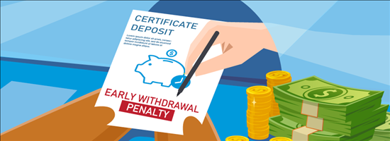
What Happens when a CD Matures?
When a CD matures, or expires, there’s a grace period of about a week in which you can withdraw funds.
After that period, many CDs automatically renew for the same or similar term they had previously, but the rate will likely be based on the rate for new CDs of that term, not your CD's original rate.
If you withdraw before a CD matures, however, you tend to pay a penalty that consists of several months to a year’s worth of interest.

Slide 68
Savings Account
A savings account is a deposit account that typically earns interest, is federally insured and held at a financial institution, such as a bank or credit union.
With an interest-bearing account, the bank pays you to keep your funds deposited, with annual percentage yields on some accounts reaching over 5%.
As deposit accounts, savings accounts are by definition federally insured up to at least $250,000.
  This means you won’t lose your money (up to at least $250,000) if the bank fails.
Savings accounts give regular access to your money. You can deposit and withdraw from a savings account relatively freely.

Slide 69
How Much to Keep in Your Savings Account
You generally want to keep building up your savings account until you reach an amount that could cover three to six months’ worth of living expenses.
  This helps protect you in case of job loss or another financial emergency.
Start by making automatic deposits to savings on a regular basis, such as each payday.
  If you’re able to save $25 a week, for example, it adds up to more than $500 after five months.
  That could help you pay for an unexpected expense, such as a surprise car repair bill, without going into debt.
If you have the ability, consider using a savings account to save for additional short-term savings goals, such as a car or special vacation.
If you have a cushion and want to save for longer-term goals, such as retirement, consider putting extra funds into investments.

Slide 70
U.S. Savings Bond
A savings bond is a loan to the U.S. government that’s issued by the U.S. Treasury.
When you buy one, you are lending money to the government.
You can register yourself or someone else (even if they’re under 18) as the owner or co-owner of a savings bond and only a bond’s owner or beneficiary can cash it.
There are two types available for purchase, series EE and series I savings bonds, and you can buy them in an electronic format on the U.S. Treasury’s website, TreasuryDirect.gov.
Unlike other types of bonds, you can’t sell savings bonds to other investors or hold them in brokerage accounts.

Slide 71

Series EE vs. Series I Savings Bond
The main difference between these two savings bonds is how their rates work.
A series EE bond has a fixed rate and earns interest plus a guaranteed return of double the value if kept for 20 years.
A series I bond has a rate that combines two things: a fixed rate and an inflation-adjusted rate calculated twice a year.
  The idea is that your money is protected from inflation, which is the overall rise in prices for goods and services (so you need more U.S. dollars to pay for the same items over time).

Slide 72
U.S. Savings Bond
Risk
  Savings bonds are one of the safest types of investments available because they’re backed by the full faith and credit of the U.S. government.
Amounts and limits
  You can buy an EE or I bond at face value for any amount from $25 to $10,000.
Terms
  Savings bonds earn interest for 30 years, but you can withdraw penalty-free after five years.
When should you consider a savings bond?
  A savings bond might be considered for investors who want to avoid risk and have a long time frame for redemption.
  You can also give a bond as a gift to loved ones, including children, or bestow someone with inheritance money.
  Savings bonds aren’t part of investment or bank accounts and aren’t useful for short-term savings goals.

Slide 73

Requirement 6
Explain to your counselor why people might purchase the following types of insurance and how they work:
  Automobile
  Health
  Homeowner's/Renter's
  Whole life and term life

Slide 74
What Is Insurance?
Insurance is a financial safety net, helping you and your loved ones recover after something bad happens — such as a fire, theft, lawsuit or car accident.
When you purchase insurance, you’ll receive an insurance policy, which is a legal contract between you and your insurance provider.
When you suffer a loss that’s covered by your policy and file a claim, insurance pays you or a beneficiary, based on the terms of your policy.
The most difficult thing about insurance is that you’re paying for something you hope you never have to use, but suffering a loss without insurance can put you in a difficult financial situation or bankruptcy.
Whenever you need to use your insurance, typically you first must pay an amount called a deductible, which can vary based on your insurance plan.
This means that the insurance company will pay for all costs exceeding the amount of your deductible, up to the total value of your insurance plan.
Insurance is a smart way of managing risk and being prepared for the worst.

Slide 75

Automobile Insurance
Car insurance is required in most states in order to own or drive a car.
The cost of car insurance depends on many different factors like where you live, your age, your driving record, and what kind of car you drive.
Auto insurance pays for injuries or property damage after an accident, up to the policy’s limits.
The cost of an accident can quickly add up.
  For example, the average cost of property damage after an accident is $5,700 per vehicle, according to 2021 data from the National Safety Council.
  If injuries or death occur, expenses can climb to more than $120,000 per person.
  Unless you have $120,000 stashed in your sock drawer, a car accident could result in serious financial ruin.

Slide 76
What Automobile Insurance Covers
Here are some of the most common types of car insurance coverage and what they cover:
  Liability Coverage: pays for medical bills or property repair costs that result from an accident you caused.
  Uninsured Motorist Coverage: pays for your own medical bills and property repair costs if you’re hit by someone without car insurance.
  Underinsured Motorist Coverage: pays out if the cost of your own medical bills and property damage exceeds the other driver’s liability coverage limits.
  Collision Coverage: pays for your own traffic-related car repair expenses (after you pay your deductible) no matter who is at fault in a crash.
  Comprehensive Coverage: pays for repair costs from inclement weather like tornadoes or hurricanes as well as vandalism or hitting a wild animal.
  Medical Payments Coverage: pays the medical expenses for you and your passengers after an accident, no matter which driver is at fault.
  Gap Insurance Coverage: pays the difference between what you owe on your car loan or lease and the vehicle’s current market value if you total your car.

Slide 77
Health Insurance
Health insurance is a policy that covers a percentage of doctors' visits and hospital bills.
  It exists to help offset the costs of medical events, whether they're planned or happen unexpectedly.
Having insurance doesn’t mean your health care will be free.
  In return for your premium, the insurance company agrees to share the cost of covered medical services with you.
  You may also have copayments — or other out-of-pocket fees — or have to meet deductibles every year before insurance coverage kicks in.
Prevention is always better than treatment, and with health insurance, you’ll be able to visit physicians for routine checkups, rather than only in case of an emergency.
Additionally, most people in their early 20s and younger can remain on their parent’s health insurance plans.

Slide 78
Health Insurance
Under the health care law, insurance companies can account for only 5 things when setting premiums.
  Age: Premiums can be up to 3 times higher for older people than for younger ones.
  Location: Where you live has a big effect on your premiums. Differences in competition, state and local rules, and cost of living account for this.
  Tobacco use: Insurers can charge tobacco users up to 50% more than those who don’t use tobacco.
  Individual vs. family enrollment: Insurers can charge more for a plan that also covers a spouse and/or dependents.
  Plan category: There are five plan categories – Bronze, Silver, Gold, Platinum, and Catastrophic. The categories are based on how you and the plan share costs. Bronze plans usually have lower monthly premiums and higher out-of-pocket costs when you get care. Platinum plans usually have the highest premiums and lowest out-of-pocket costs.

Slide 79
Important Health Insurance Terms and Concepts
Out-of-pocket expenses:
  The terms "out-of-pocket cost" and/or "cost sharing" refer to the portion of your medical expenses you are responsible for paying when you actually receive health care.
  The monthly premium you pay for care is separate from these costs.
Annual deductible:
  The annual deductible is amount you pay each plan year before the insurance company starts paying its share of the costs.
  If the deductible is $2,000, then you would responsible for paying the first $2,000 in health care you receive each year, after which the insurance company would start paying its share.
Copayment (or 'Copay'):
  The copay is a fixed, upfront amount you pay each time you receive care when that care is subject to a copay.
  For example, a copay of $30 might be applicable for a doctor visit, after which the insurance company picks up the rest.

Slide 80
Important Health Insurance Terms and Concepts
Coinsurance:
  Coinsurance is a percentage of the cost of your medical care.
  For an MRI that costs $1,000, you might pay 20 percent ($200) while your insurance company will pay the other 80 percent ($800).
Annual out-of-pocket maximum:
  The annual out-of-pocket maximum is the most cost-sharing you will be responsible for in a year.
  It is the total of your deductible, copays, and coinsurance (but does not include your premiums).
  Once you hit this limit, the insurance company will pick up 100 percent of your covered costs for the remainder of the plan year.
Covered Benefit:
  A 'covered benefit' generally refers to a health service that is included under the premium for a given health insurance policy that is paid by, or on behalf of, the enrolled patient.
  It does not mean that the service will be paid at 100%.

Slide 81
Homeowners Insurance
Homeowners insurance covers your house and belongings in case of events such as fires, hail, tornadoes and burst pipes.
  Standard homeowners insurance doesn't cover damage caused by floods, earthquakes, acts of war, terrorism, civil unrest, nuclear accidents or radiation.
If one of the covered scenarios causes damage, you can file a claim with your insurance company.
  You will receive payment for covered losses, minus any home insurance deductible, up to your policy's coverage limit.
Homeowners insurance can also reimburse you for theft or vandalism of your belongings.
It can also pay to defend you from lawsuits or cover medical bills for someone who gets hurt on your property.
If you can’t live at home after a covered disaster, your homeowners policy could pick up the tab for a hotel or rental.

Slide 82

Renter’s Insurance
Anyone living in a rental unit with more possessions than they can afford to replace should consider a renter's insurance policy.
Renters insurance protects against the loss of personal belongings.
In addition, renters insurance covers the policyholder's legal and liability expenses related to lawsuits resulting from accidents occurring on the rental property.
It can also compensate for additional living expenses if the policyholder and other covered occupants are forced to relocate temporarily due to a covered disaster.
Renters insurance won't cover the actual structure you live in; that's your landlord's responsibility.

Slide 83

Life Insurance
Life insurance is a contract between a life insurance company and a policy owner.
A life insurance policy guarantees the insurer pays a sum of money to one or more named beneficiaries when the insured person dies in exchange for premiums paid by the policyholder during their lifetime.

Slide 84
Purpose of Life Insurance
Replace income for dependents
  If people depend on an individual’s income, life insurance can replace that income if the person dies. The most common example of this is parents with young children.
  Insurance to replace income can be especially useful if the government- or employer sponsored benefits of the surviving spouse or domestic partner will be reduced after their companion dies.
Pay final expenses
  Life insurance can pay funeral and burial costs, probate and other estate administration costs, debts and medical expenses not covered by health insurance.
Create an inheritance for heirs
  Even those with no other assets to pass on, can create an inheritance by buying a life insurance policy and naming their heirs as beneficiaries.

Slide 85
Purpose of Life Insurance (continued)
Pay federal “death” taxes and state “death” taxes
  Life insurance benefits can pay for estate taxes so that heirs will not have to liquidate other assets or take a smaller inheritance.
Make significant charitable contributions
  By making a charity the beneficiary of their life insurance policies, individuals can make a much larger contribution than if they donated the cash equivalent of the policy’s premiums.
Create a source of savings
  Some types of life insurance create a cash value that, if not paid out as a death benefit, can be borrowed or withdrawn on the owner’s request.
  Since most people make paying their life insurance policy premiums a high priority, buying a cash-value type policy can create a kind of “forced” savings plan.
  Furthermore, the interest credited is tax deferred (and tax exempt if the money is paid as a death claim).

Slide 86
Term Life Insurance
Term life insurance covers you for a period of time chosen at purchase, such as 10, 20 or 30 years.
If you die during the covered period, the policy will pay your beneficiaries the amount stated in the policy.
If you don’t die during that time, no one gets paid.
Term life is popular because it offers large payouts at a lower cost than permanent life.
It also provides coverage for a set number of years.

Slide 87
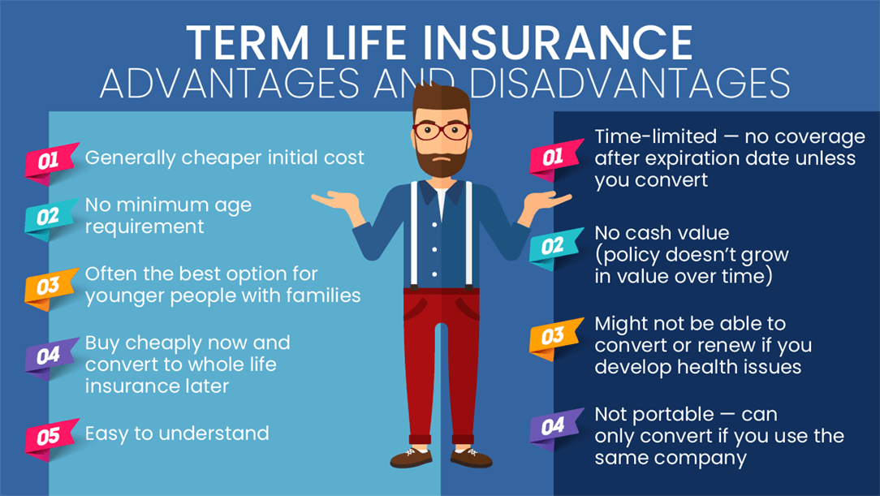

Slide 88
Whole Life Insurance
Whole life insurance is a type of permanent life insurance that comes with three key features:
  It generally lasts your entire life.
  Your premiums are locked in and won’t change as long as you have the policy.
  It has a cash value component (similar to a savings account that earns interest over time.)
Whole life premiums are a lot higher than term life insurance premiums.
  For example, $500,000 of whole life coverage for a healthy 30-year-old woman costs around $4,015 annually, on average.
  That same level of coverage with a 20-year term life policy would cost an average of about $188 annually.

Slide 89
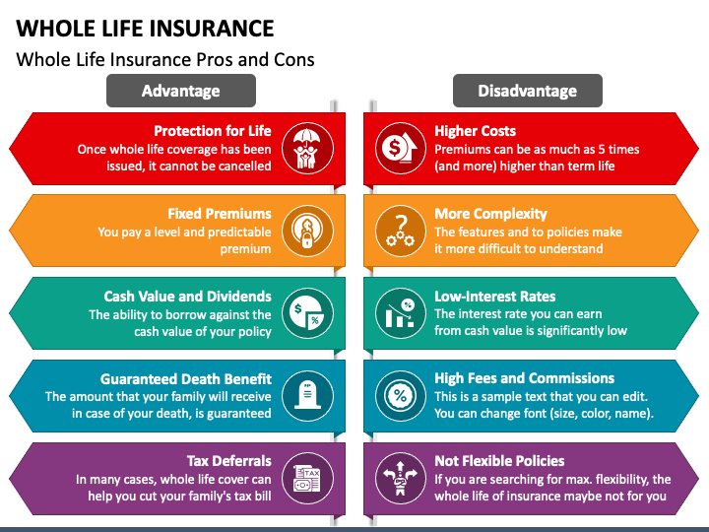
Insurance agents receive the highest commissions for whole life insurance.

Slide 90
Requirement 7
Explain to your merit badge counselor the following:
  What a loan is, what interest is, and how the annual percentage rate (APR) measures the true cost of a loan.
  The different ways to borrow money.
  The differences between a charge card, debit card, and credit card. What are the costs and pitfalls of using these financial tools? Explain why it is unwise to make only the minimum payment on your credit card.
  Credit reports and how personal responsibility can affect your credit report.
  Ways to reduce or eliminate debt.

Slide 91
What Is a Loan?
A loan is a sum of money that you borrow from a financial institution (bank, credit union or online lender) or a person, like a family member, and pay back in full at a later date, typically with interest.
Loans generally have four primary features: principal, interest, installment payments and term.
  Principal: This is the amount of money you borrow from a lender. As you repay your loan, the principal is the outstanding balance aside from interest or fees.
  Interest: The interest rate is the cost of a loan; how much you have to pay back in addition to the principal. Lenders determine your interest rate based on several factors, including your credit score, the type of loan and how much time you need to repay it.
  Installment payments: Loans are usually repaid at a regular cadence, typically monthly, to the lender. Your monthly payment is commonly a fixed amount.
  Term: The loan term is how much time you have to repay the loan in full. Depending on the type of loan, the term can range from a few weeks to several years.

Slide 92
What Is Annual Percentage Rate (APR)?
An annual percentage rate (APR) is the yearly rate charged for a loan or earned by an investment and includes interest and fees.
Financial institutions must disclose a financial instrument’s APR before any agreement is signed.
The APR provides a consistent basis for presenting annual interest rate information in order to protect consumers from misleading advertising.
The APR provides consumers with a bottom-line number they can compare among different lenders or credit cards,
APR shouldn't be confused with APY (annual percentage yield), which refers to money earned in a savings account or other investment, rather than the interest rate paid on a loan.

Slide 93

Different Ways to Borrow Money.
Payday Loans:
  Payday loans range in size from $100 to $1,000, depending on state legal maximums.
  The average loan term is about two weeks.
  Loans typically cost 400% annual interest (APR) or more.
  The finance charge ranges from $15 to $30 to borrow $100. For two-week loans, these finance charges result in interest rates from 390 to 780% APR. Shorter term loans have even higher APRs.
  Avoid payday loans at all costs.

Slide 94

Different Ways to Borrow Money.
Pawnshop Loan:
  Like a secured loan from a bank, a pawnshop loan requires you to put up an item as collateral. Think jewelry, antiques or electronics. Once you bring the item in, the pawnshop assesses its value, condition and resale potential and makes you an offer.
  If you accept the amount, you walk away with the cash and a pawn ticket. Upon repayment, you can re-collect your item. If you fail to repay by the deadline — 30 days on average — the pawnshop keeps it.
  A pawnshop loan doesn’t have a loan approval process and can be a quick way to borrow money without requiring your credit score. However, in addition to the interest rate charged on the loan, pawnshops charge fees for storage, appraisal and insurance that can result in an APR as high as 200%.
  Avoid pawnshop loans at all costs.

Slide 95

Different Ways to Borrow Money.
Credit Cards:
  A credit card cash advance is a way to get cash from a credit card’s credit line.
  The main costs associated with a credit card cash advance are the card’s cash advance fee and cash advance APR, and interest begins accruing on a cash advance immediately.
  Cash advance APRs can be as high as 36%.
  As a result, a credit card cash advance should be done only in emergency situations.

Slide 96

Different Ways to Borrow Money.
Family/Friend Loan:
  Though it can be difficult to ask, borrowing from someone you know could be a fast and affordable solution.
  You’ll avoid the sometimes lengthy formal application and approval processes required by other types of lenders.
  There’s also no credit check required with this type of loan.
  However, this will put a strain on your relationships if you are unable to pay the amount back.

Slide 97

Different Ways to Borrow Money.
Bank Loans:
  Banks or credit unions typically offer some of the lowest annual percentage rates, which represents the total cost of borrowing, for personal loans.
  Loan amounts range from a few hundred dollars to $50,000 or more.
  The interest rate you get on a loan depends on your credit score and credit history, annual income, existing debt and your lender.
  If you don’t have good credit, however, it’s hard to get approved through a bank.

Slide 98
How to Reduce Costs for a Loan.
Shop around:
  Different lenders charge different interest rates.
  An interest rate just one percentage point lower can provide substantial savings.
Compare the Annual Percentage Rate (APR):
  The APR reflects the true percentage rate of a loan because it takes into account various fees and other costs over a year.
Ask what the total cost of the loan will be:
  The lender is required by law to disclose this.
Find out the amount of any and all fees:
  Fees add up quickly and can greatly increase the cost of a loan.
Do not always choose the loan with the lowest payment:
  A lower payment might mean a longer payment period. The longer you take to repay a loan, the more you will pay in total interest charges.
Ask if there is a charge for paying off the loan early:
  Avoid loans that penalize you for repaying early. Paying off early can save you interest payments.

Slide 99

Car Buying Game
You were just hired for the best summer job of all time and now need a car.

Slide 100

I can get you into this car for less than $500/month.
Do You Want It?
Monthly Payment = $465
Term = 48 months
Interest = 5.5%

Slide 101
I can get you into this car for less than $400/month and I will give you longer to pay.
Do You Want It?
Monthly Payment = $386
Term = 60 months
Interest = 6%

Slide 102
For $1000 fee, I can lower your interest rate and get you into this car for about $300/month.
Do You Want It?
Monthly Payment = $310
Term = 60 months
Interest = 5.5%
Fee = $1000

Slide 103
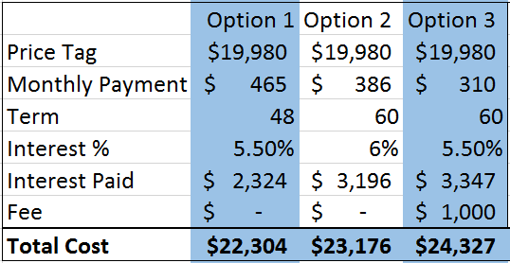
Who Got the Best Deal?

Slide 104
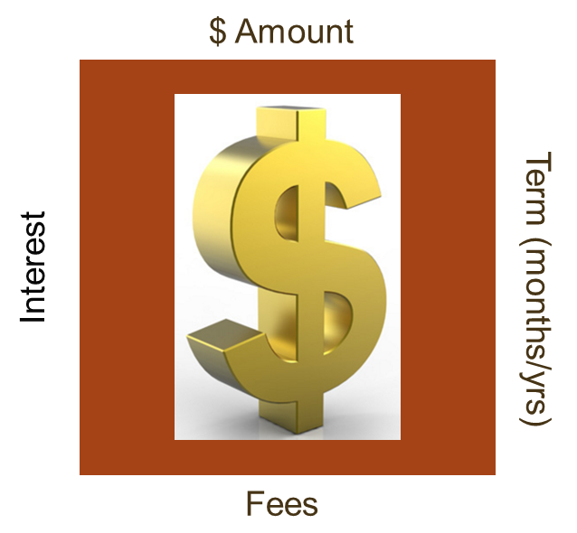
They are going to get their money
How much more they gouge you depends on your ability to understand their tactics.

Slide 105
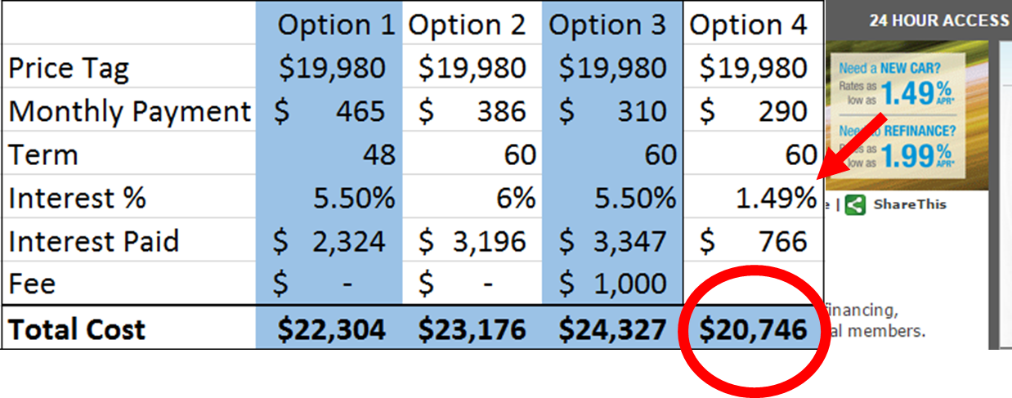
How Not to Fall Prey to Predatory Lending
Arrange your financing in advance!

Slide 106

What Has the Most Impact on Total Cost of Credit?
The Loan Term
  In general, the longer the term of the loan, the higher the cost of borrowing.
  Longer-term loans generally have higher interest rates than shorter-terms loans.
  Even if the interest rates are equal, when you take longer to pay, there are more payment periods on which interest is applied.

Slide 107
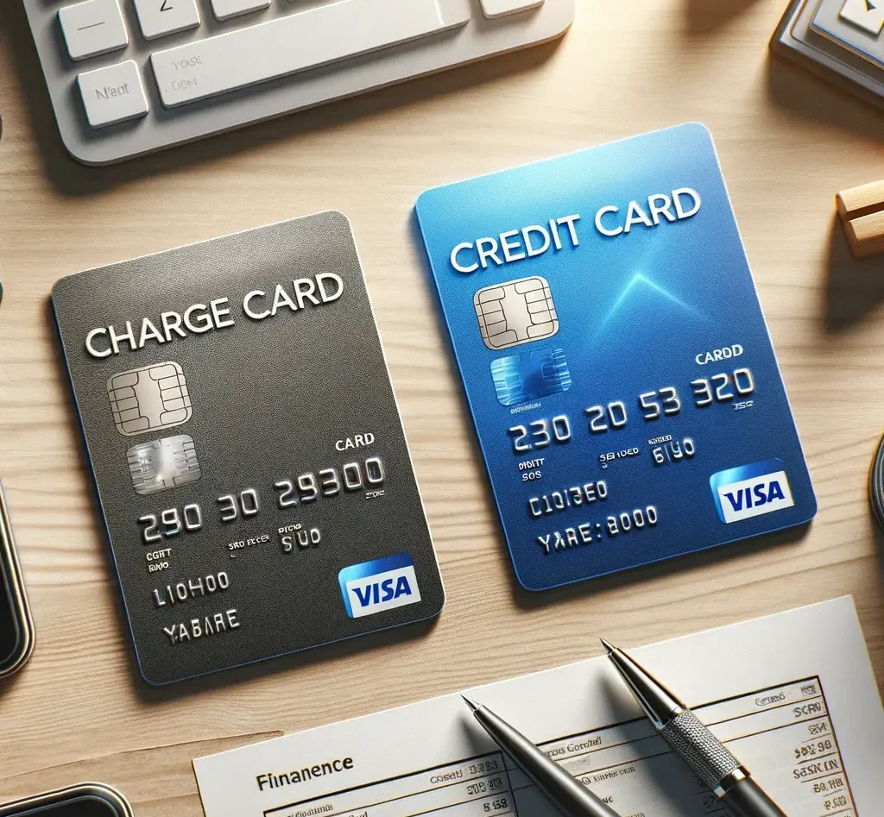
Credit Card versus Charge Card
Credit cards permit card holders to carry a balance from month to month, subject to interest charges.
  This provides flexibility in repayment.
  The rewards programs offered by credit cards tend to be more varied and generous compared to charge cards.
Charge cards mandate that the full balance be paid each billing cycle.
  No long-term carrying balances are permitted.
  Charge cards have no interest rates and fees are also typically lower compared to most credit cards.

Slide 108

About Credit Cards
A credit card is a high-interest unsecured loan.
It offers multiple transaction types, including:
  Purchases.
  Balance transfers.
  Cash advances.
They often have incentives to entice you to spend money, hoping you will not be able to pay the full balance off.
  Low promotional interest rates.
  Store discounts.
  Rewards programs (points or cash back).

Slide 109
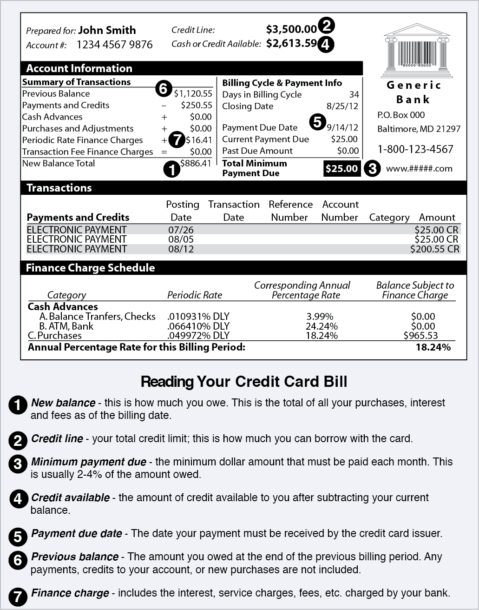
Understanding Your Credit Card Bill

Slide 110
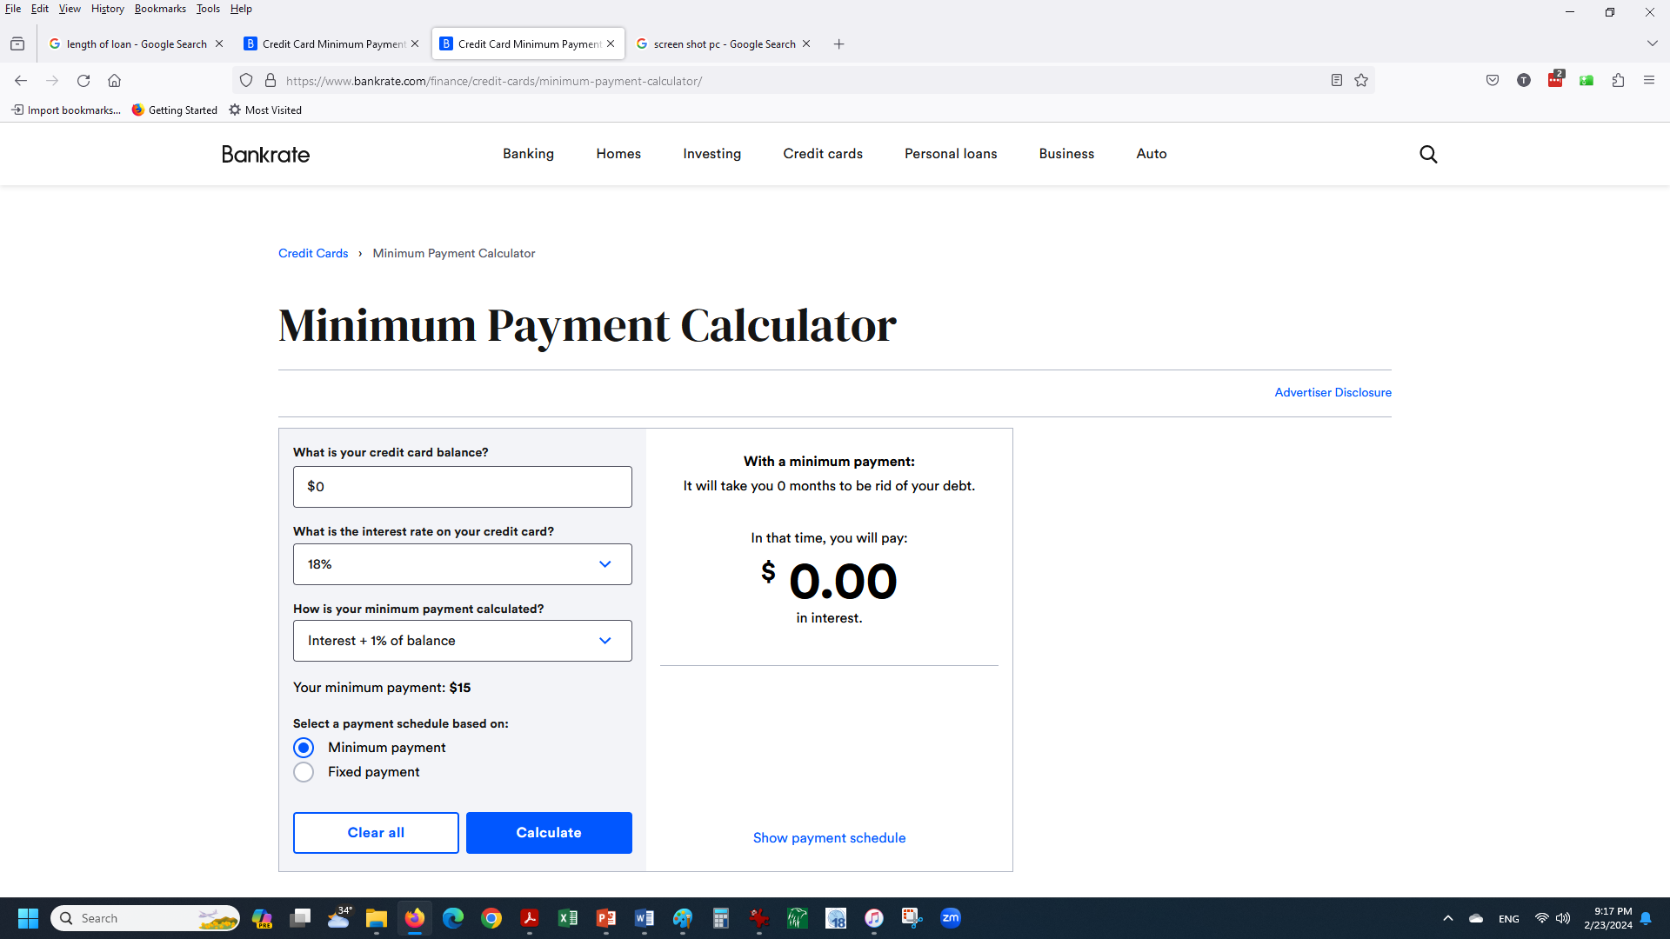
Credit Card Minimum Payment Calculator
Lesson 3: A Fresh Start
110
Click on the link at the top to access the online minimum payment calculator.

Slide 111
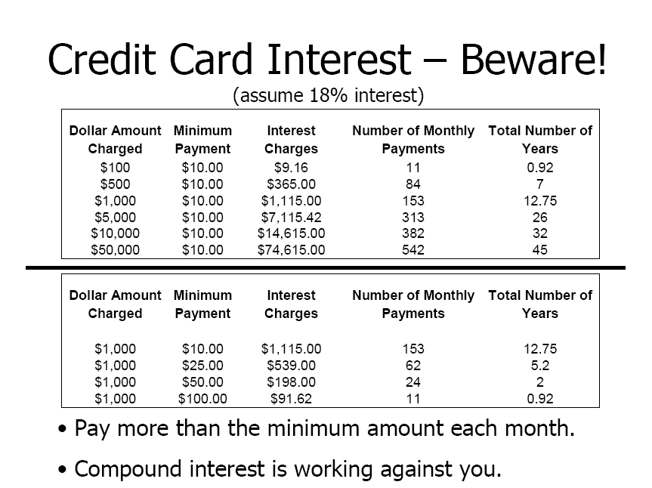
Repayment Example

Slide 112
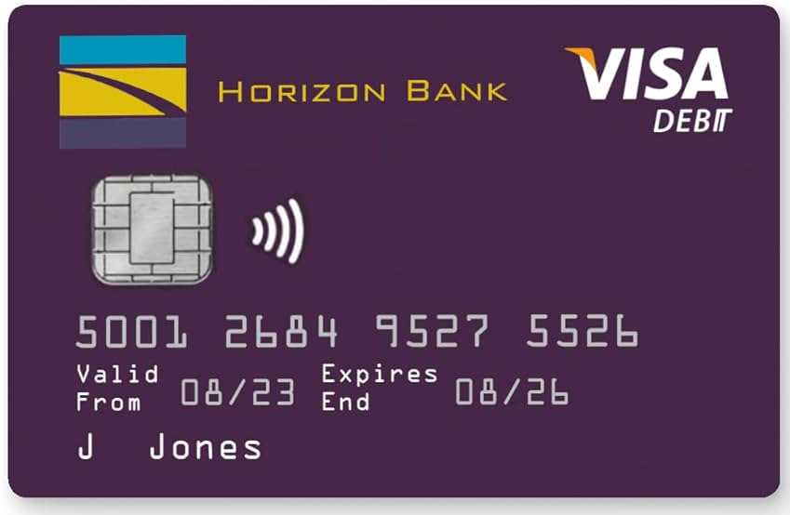
Debit Card
A debit card is a payment card that deducts money directly from your checking account.
Debit cards reduce the need to carry cash or physical checks to make purchases.
You can use debit cards at ATMs to withdraw cash.
You may be charged an ATM transaction fee if you use your debit card to withdraw cash from an ATM that's not affiliated with your bank.

Slide 113

Credit Reports
A credit report is a summary of your credit history, including the types of credit accounts and loans you’ve had, your payment history, your credit limits, and the status of your credit accounts.
The information on your credit report is used to calculate your credit scores.
A credit score is usually a three-digit number ranging from approximately 300 to 850.
The higher your score, the better the terms of credit you are likely to receive.

Slide 114
Credit Reports
Lenders use your credit reports as part of their evaluation process when deciding whether to extend you credit and at what terms.
  Suppose you want to borrow $200,000 in the form of a fixed rate thirty-year mortgage. For a credit score between 760-850, your loan interest rate might be 3.307%, resulting in a $877 monthly payment. For a credit score between 620-639, your loan interest rate might be 4.869%, resulting in a $1,061 monthly payment. The lower credit score would cost you $184 per month more for your mortgage. Over the life of the loan you would pay $66,343 more than the best credit score. Think about what you could do with that extra $184 per month.
By not overspending, never missing payments, and being responsible with your finances, your credit score will gradually improve and, in turn, you will be able to pay less when borrowing money.

Slide 115
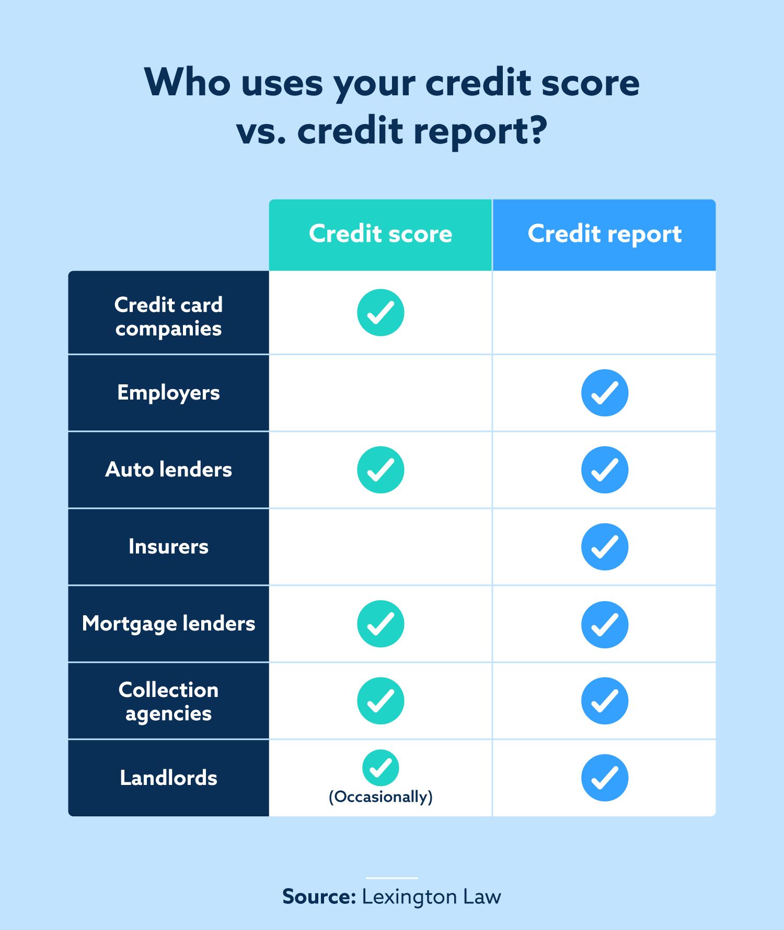
Who Else Uses Credit Reports?
Insurance companies may use the information to decide whether you can get insurance and to set the rates you will pay.
Employers may use your credit report, if you give them permission to do so, to decide whether to hire you.
Telephone and utility companies may use information in your credit report to decide whether to provide services to you.
Landlords may use the information to determine whether to rent an apartment to you.

Slide 116
Two Strategies to Reduce or Eliminate Debt
Highest Interest Rate Method
  This approach focuses on your debts like credit card and student loan debts with the highest rate of interest. The goal is to pay off the highest interest rate debt as quickly as possible, because it’s costing you the most. While it may not feel like you’re making progress, this method will help you eliminate your costliest debts first—which can save you money in the long run.
Snowball Method
  This approach focuses on your smallest debt. The goal is to get rid it as soon as possible. You keep on making the minimum payments on all of your debts, and you put any extra funds you have toward paying off the smallest debt. This will help you pay it off sooner.
  Once you’ve paid one smaller debt in full, dedicate that freed up money to the next smallest debt. This way, you create a “snowball” of payments as you eliminate each debt. Unlike the higher interest rate method, you’ll see progress quickly as you pay off smaller debts. However, you may end up paying more in the long run, as you won’t be focusing on the larger or more costly debts.

Slide 117
Requirement 8
Demonstrate to your merit badge counselor your understanding of time management by doing the following:
  Write a "to do" list of tasks or activities, such as homework assignments, chores, and personal projects, that must be done in the coming week. List these in order of importance to you.
  Make a seven-day calendar or schedule. Put in your set activities, such as school classes, sports practices or games, jobs or chores, and/or Scout or place of worship or club meetings, then plan when you will do all the tasks from your "to do" list between your set activities.
  Follow the one-week schedule you planned. Keep a daily diary or journal during each of the seven days of this week's activities, writing down when you completed each of the tasks on your "to do" list compared to when you scheduled them.
  With your merit badge counselor, review your "to do" list, one-week schedule, and diary/journal to understand when your schedule worked and when it did not work. Discuss what you might do differently the next time.

Slide 118

Time Management
Download the “Time Management Exercise” and the “Time Management Calendar” that accompanies this presentation to help you with the completion of Requirement 8.

Slide 119
Requirement 9
Prepare a written project plan demonstrating the steps below, including the desired outcome. This is a project on paper, not a real-life project. Examples could include planning a camping trip, developing a community service project or a school or religious event, or creating an annual patrol plan with additional activities not already included in the troop annual plan. Discuss your completed project plan with your merit badge counselor.
  Define the project. What is your goal?
  Develop a timeline for your project that shows the steps you must take from beginning to completion.
  Describe your project.
  Develop a list of resources. Identify how these resources will help you achieve your goal.
  Develop a budget for your project.

Slide 120
Planning a Project
Download the “Project Planning Exercise”, “Project Plan Worksheet – Example”, and the “Project Plan Worksheet – Blank” that accompanies this presentation to help you with the completion of Requirement 9.

Slide 121
Requirement 10
Do the following:
  Choose a career you might want to enter after high school or college graduation. Discuss with your counselor the needed qualifications, education, skills, and experience.
  Explain to your counselor what the associated costs might be to pursue this career, such as tuition, school or training supplies, and room and board. Explain how you could prepare for these costs and how you might make up for any shortfall.

Slide 122

Career Example
What are the major steps to becoming a doctor?
  Graduate from high school with strong academics
  Attend and finish college – 4 years
    Earn a bachelor’s degree
    Complete prerequisite courses for medical school
    Take the Medical College Admission Test (MCAT)
    Apply to medical school
  Attend and finish medical school – 4 years
  Complete a residency training program in your desired field – 3-7 years
  Complete a fellowship in a subspecialty area 1-3 years
  11+ years required to become a doctor.

Slide 123
Costs to Becoming a Doctor
Undergraduate Degree:
  According to the Education Data Initiative (EDI), the average cost of college—including books, supplies, and living expenses—is $36,436 per year. If you graduate in four years, that means paying $145,744 for your undergraduate degree. The price tag is even higher at private schools with degrees costing up to $223,360.
Medical School:
  Data shows that the average cost of a medical school education is $218,792, putting the average price of an undergraduate degree and medical degree at a whopping $364,536. Of course, this is just an average. You could pay far less by going to in-state schools and earning scholarships or far more if you go to expensive private universities. It also does not account for any interest that accrues on student loans you take.
Physicians Salaries:
  Physicians made a median salary of $227,180 in 2022. The best-paid 25% made $239,200 that year, while the lowest-paid 25% made $120,000.

Slide 124
How to Pay for College
529 College Savings Plans.
  A 529 plan is a savings account that provides several tax and financial aid advantages and allows you to pay for college tuition or all of the expenses related to getting that education.
Federal Financial Aid.
  Students should always borrow federal first, as federal student loans are less expensive and have better repayment terms than private student loans.
Grants and Scholarships.
  To find scholarships, use a free scholarship search site, such as Fastweb.
Cash From Savings and Work.
  Many parents pay for college expenses out of current income as well as savings.
Work During School.
  One good way to pay for school, especially if for students who have a full or partial scholarship lined up, is to work part-time while in school. This can help pay for room and board, books, or possibly even tuition. Working full-time during the summers can help to pay for the next year’s worth of expenses.
Choose a Cheaper College to Cut Costs.
  Enroll at a less expensive college. Students should apply to a mix of several colleges based on academic fit and financial fit.

